Slide 1

Unity 3D Essentials
Course Introduction
SoftUni Team
Technical Trainers
Software University
https://softuni.bg/

Slide 2
Table of Contents
Course Program
Trainers Team
Course Organization
Duration
Practical Programming Exam

Slide 3
Have a Question?
sli.do
#Unity3D-Basics

Slide 4














SoftUni Diamond Partners

Slide 5

Course Program
Unity 3D Essentials

Slide 6
Course Program
Unity Basics
Using Game Object
Physics and Collisions
Using Canvas UI
2D Graphics, Physics & Particles
Animation & Audio
Advanced Scripting & Performance
Unity Package Manager
Mobile games publishing. AppStore & Google Play

Slide 7

Trainers Team

Slide 8
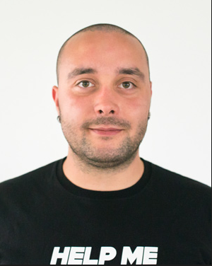
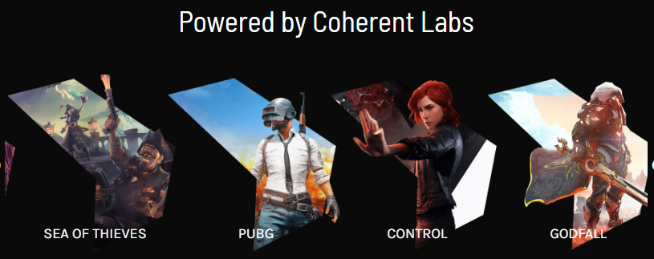
Yordan Strashilov
Unity 3D / C# .NET Developer at Coherent Labs
ASP .NET, Python, C++
MSSQL, MySQL, MongoDB
JS, HTML, CSS
Super Bad at Math

Slide 9

Course Organization

Slide 10
Training Duration
Lessons: ~15h
Practical exercises: ~15h
Exam: 4 hours
Practical exam
Schedule: Mart-June 2022
Exam date: 5th of June 2022 and 12th of June (retake)

Slide 11
Practical Programming Exam
6 problems for 4 hours
Each solved problem gives certain amount of points
Min points for passing the exam - 20
Max points - 60

Slide 12
Questions?
Notes:
‹#›

Slide 13

License
This course (slides, examples, demos, exercises, homework, documents, videos and other assets) is copyrighted content
Unauthorized copy, reproduction or use is illegal
© SoftUni – https://about.softuni.bg
© Software University – https://softuni.bg
Notes:
‹#›

Slide 14
Trainings @ Software University (SoftUni)
Software University – High-Quality Education, Profession and Job for Software Developers
about.softuni.bg, softuni.org
Software University Foundation
softuni.foundation
Software University @ Facebook
facebook.com/SoftwareUniversity
Software University Forums
forum.softuni.bg
Notes:
‹#›

